Slide 1

Test Driven Development with ABAP Graham Robinson Yelcho Systems Consulting
SESSION ID: CNA415
#ASUG
www.asug.com

Slide 2


Slide 3




Introduction
@grahamrobbo
*Photo by Martin Gillet

Slide 4
Agenda
Add Tests
See Tests Fail
Write Code
Run Tests
Refactor
Why?
How?
Some things that help
TDD

Slide 5
TDD

Slide 6
Disclaimer
This presentation isn’t really about Test-driven development

Slide 7
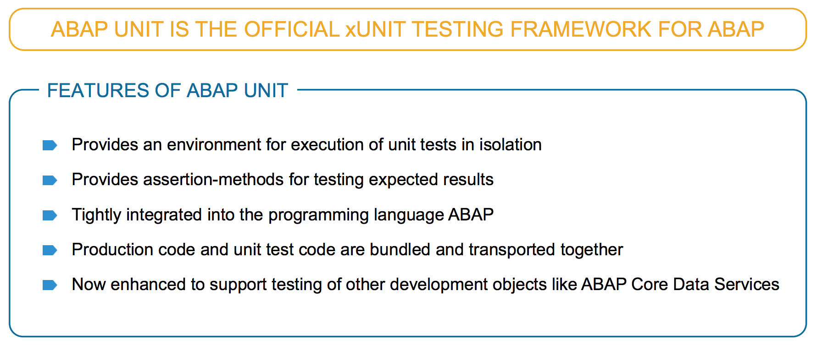
ABAP Unit – Introduction
SAP NetWeaver AS ABAP 6.40
Source: S4H232 SAP TechEd 2017

Slide 8
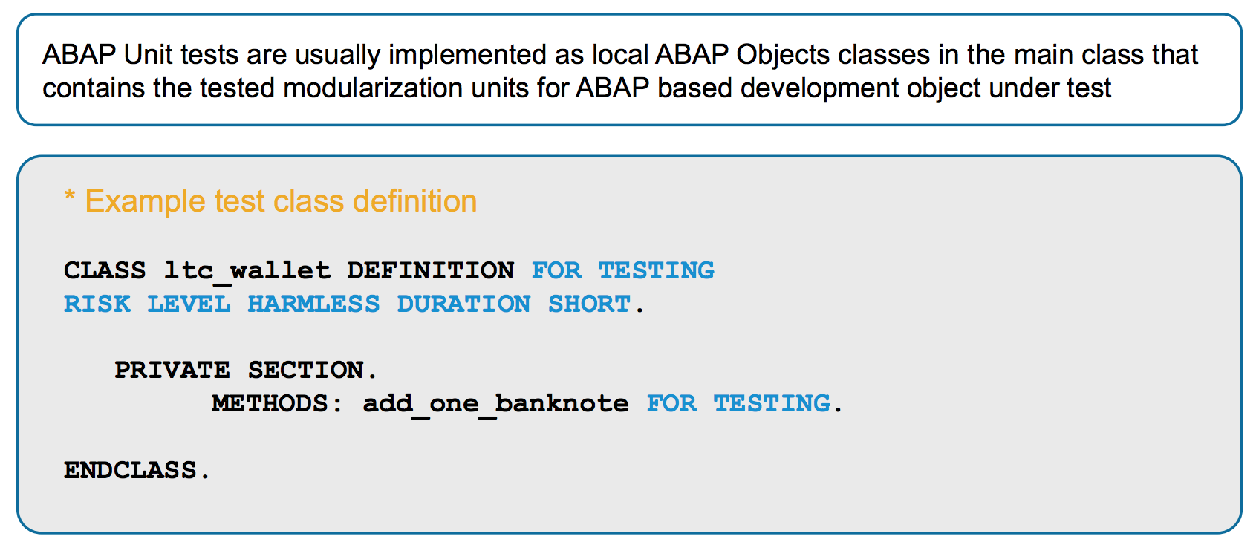
ABAP Unit – Introduction
Source: S4H232 SAP TechEd 2017

Slide 9
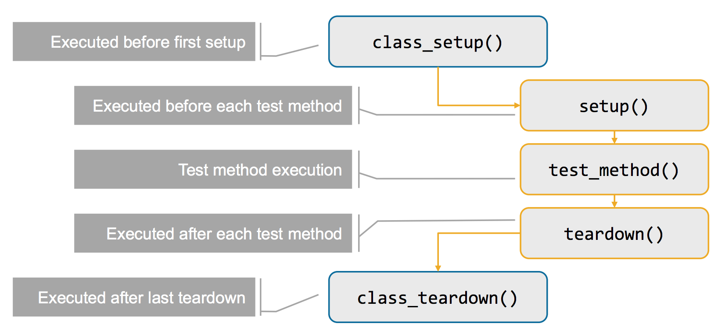
ABAP Unit – Introduction
Source: S4H232 SAP TechEd 2017

Slide 10


Slide 11
Testing is good?

Slide 12
Testing ABAP code is hard?

Slide 13
Why is it so hard to write tests?
The secret is not how to write the tests…..
… the secret is how to write …..
Testable Code

Slide 14
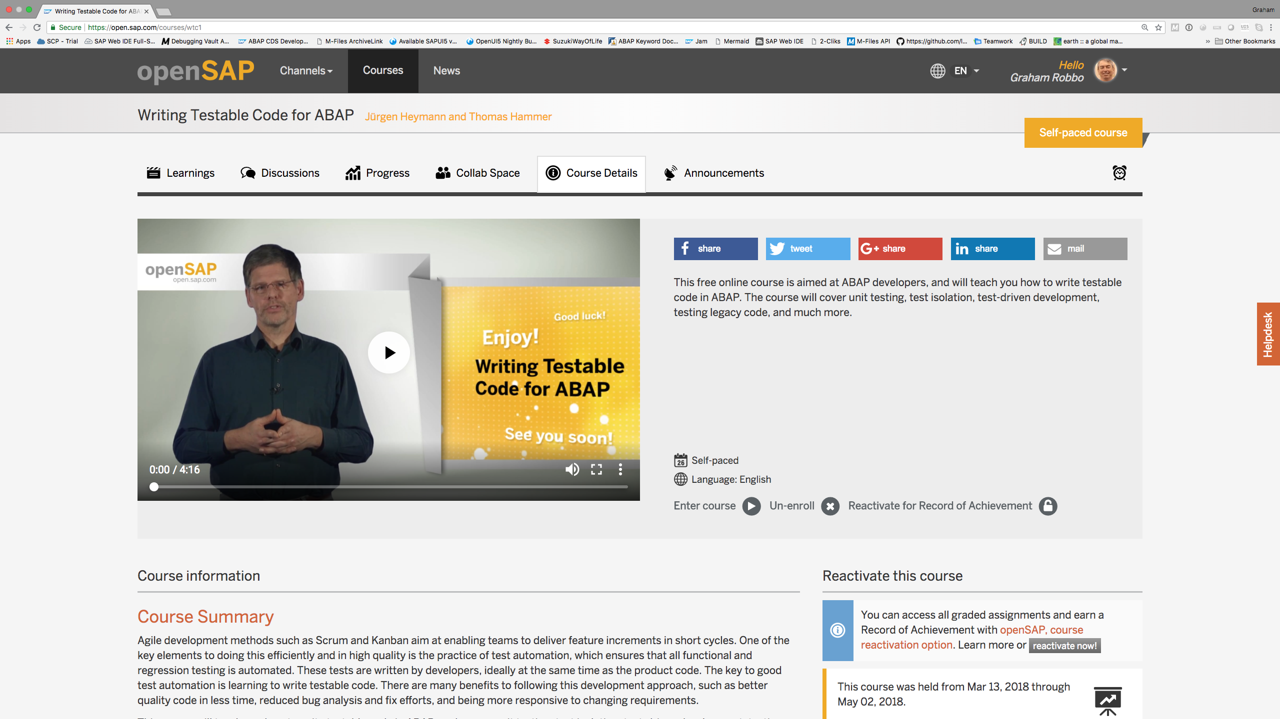
OpenSAP

Slide 15

The Testing Challenge?

Slide 16
Dependencies
A
‘depends on’
F
B
D
C
E

Slide 17
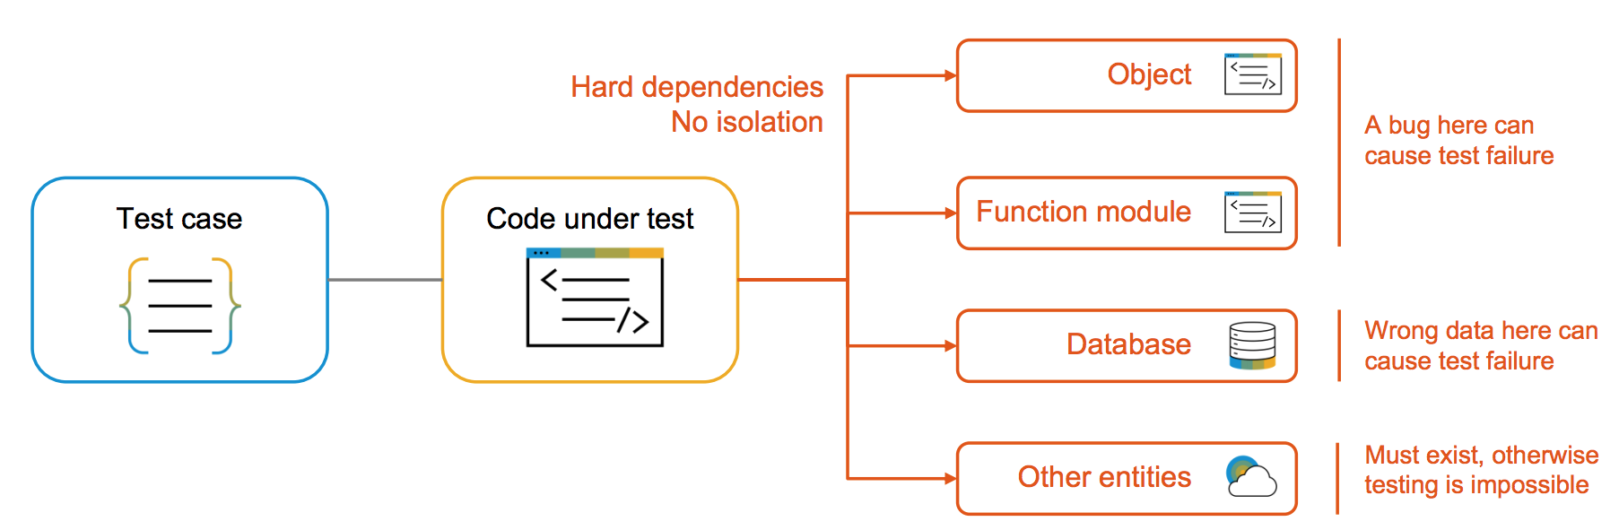
Unit Testing without Isolation
Source: S4H232 SAP TechEd 2017

Slide 18
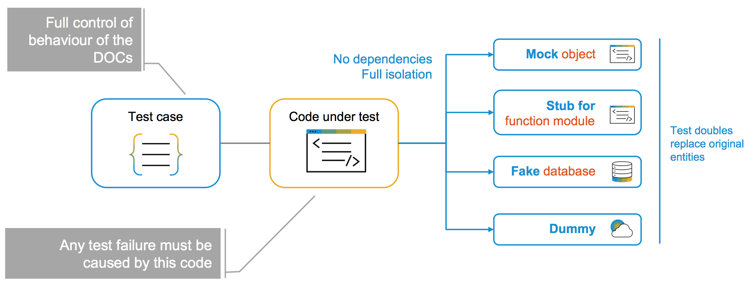
Unit Testing with Isolation
Source: S4H232 SAP TechEd 2017

Slide 19
But…legacy code…
The legacy code dilemma
In order to write tests, you would need to change the code first
In order to safely change the code, you need tests to verify you did not break the code
Strategies
Use tools to record input and output of the legacy block and replay it after the refactoring
Refactor legacy code into a object-oriented environment to test it there, e.g. convert a report to a class
Hide legacy code behind interfaces to test only your code
Encapsulate additions to legacy code in methods or classes and only test them in isolation
Source: OpenSAP Course Writing Testable Code for ABAP

Slide 20
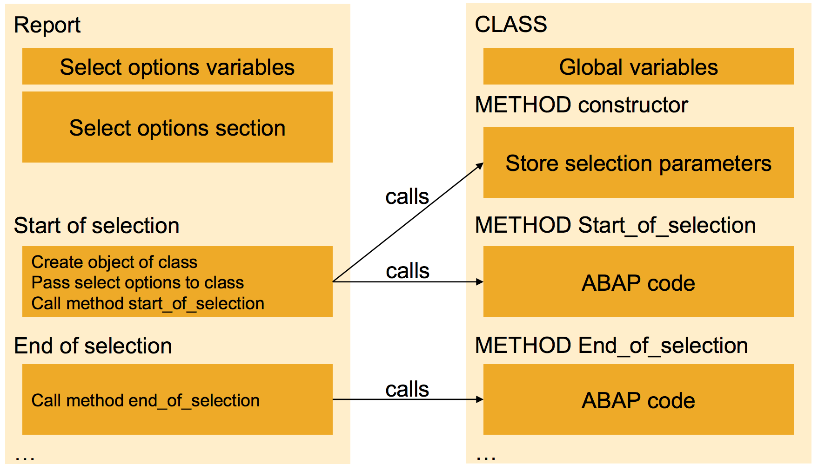
Providing Testability for Existing Code
Convert a report to a class
Replace report code with class code
Make class testable
Source: OpenSAP Course Writing Testable Code for ABAP

Slide 21
Some Help

Slide 22
Test Seams
SAP NetWeaver AS ABAP 7.50 onwards
Test seams are language constructs designed especially for unit tests and are implemented using the following statements:
TEST-SEAM - END-TEST-SEAM
Defines a test seam as a replaceable area in the production code of a program.
TEST-INJECTION - END-TEST-INJECTION
Replaces the executable statements of a test seam by the statements of an injection in a test class of the same program.
Test seams have the following properties:
Test seams are ignored in production use of programs.
A program can contain more than one test seam.
Multiple injections can be defined for a single test seam.
Injections can only be created in test classes that are defined in a test include. Test seams can be used in all executable units of a master program that includes a test include, including local classes and subroutines.
Unit tests can make injections while test methods or the setup method are being executed.
If injections are repeated in the same test seam, the last injection is the active injection.
Source: https://help.sap.com/doc/abapdocu_752_index_htm/7.52/en-US/abentest_seams.htm

Slide 24
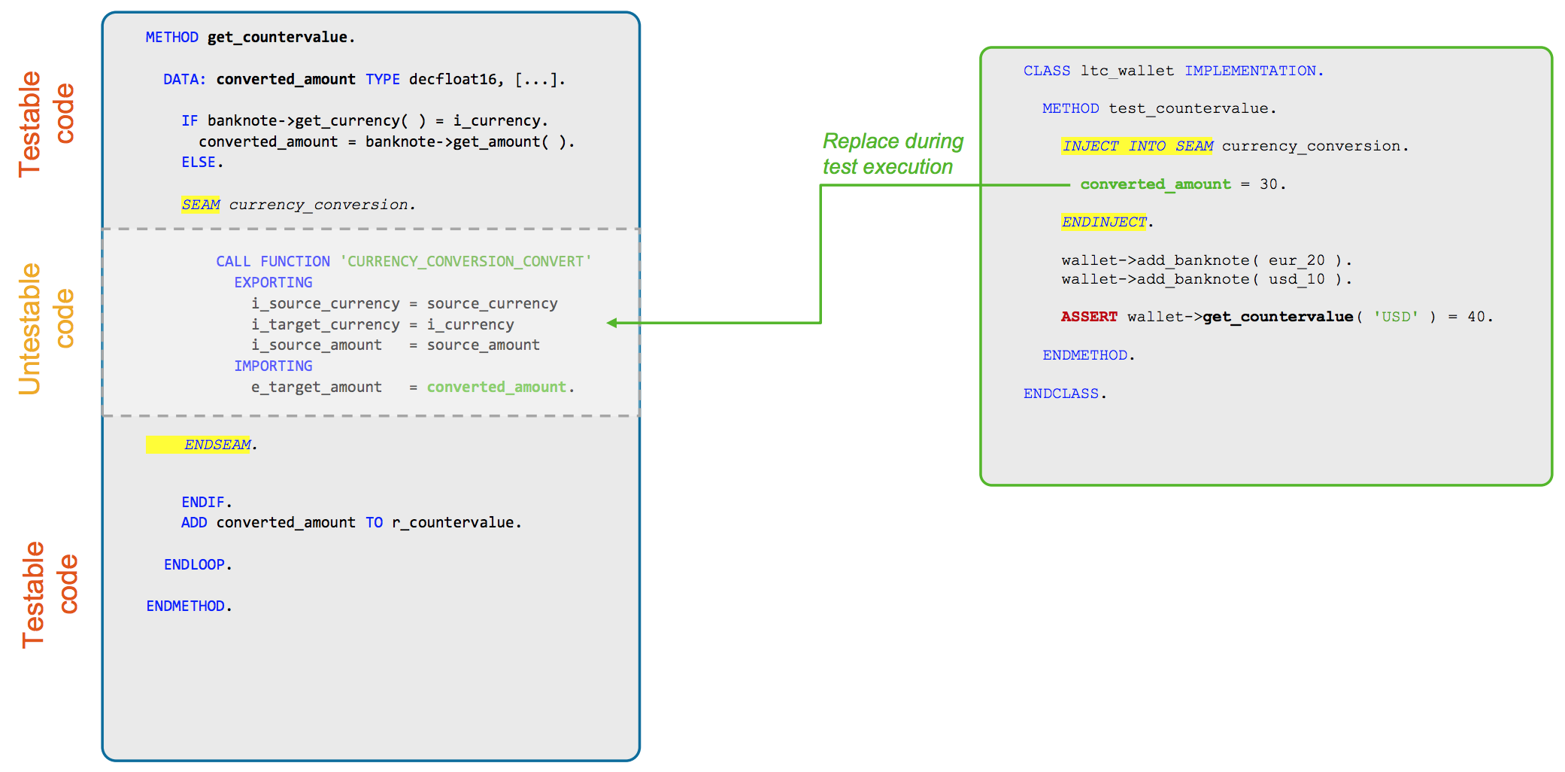
ABAP Test Seams Injection
Source: S4H232 SAP TechEd 2017

Slide 25
Test Seams
“TEST-SEAMS appear to have no benefit.”
“You have to change the production code and I have found the effort of surrounding something with a test seam is about the same as replacing whatever is surrounded with a call to a method of something that can be doubled.”
“Test seams break the rule that production code should not know it is being tested.”
“Test Seams are an abomination!”

Slide 26
Writing Testable Code
Single Responsibility Principle
Open Closed Principle
Liskov Substitution Principle
Interface Segregation Principle
Dependency Inversion Principle
Code Under Test
Dependency
Notes:
Liskov Substitution Principle also known as “Design by Contract”

Slide 27
Dependency Injection
Eliminate dependencies
Separate concerns into smaller classes for each dependency
Database
User
External System
Printer
Etc.
Implement test doubles
Image credit: https://blogs.sap.com/2015/01/05/abap-test-double-framework-an-introduction/

Slide 28
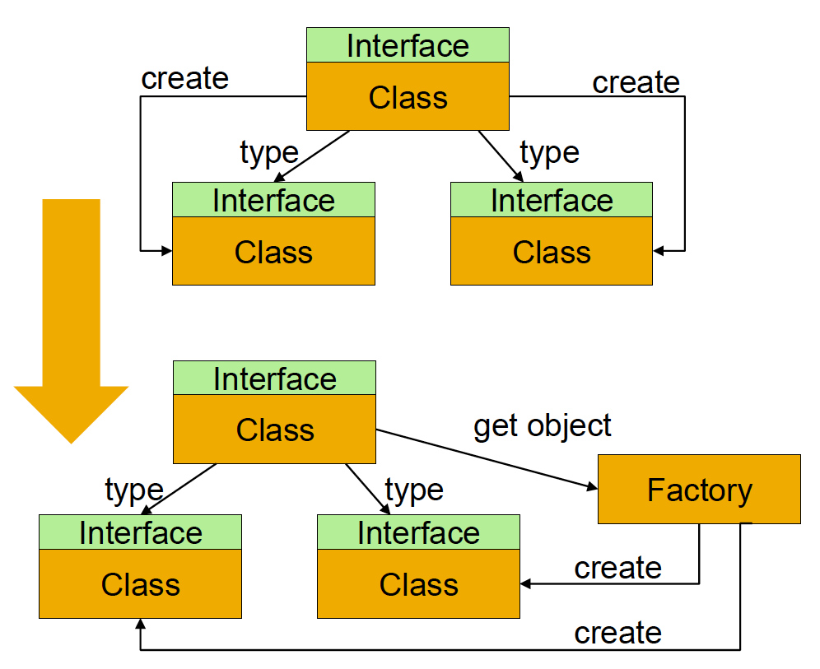
Dependency Lookup Example
The Goal
Classes of more abstract levels shall not depend on classes on more detailed levels
Classes shall only depend on abstractions, e.g. interfaces
Source: OpenSAP Course Writing Testable Code for ABAP

Slide 29
Dependency Lookup Example
The Goal
Classes of more abstract levels shall not depend on classes on more detailed levels
Classes shall only depend on abstractions, e.g. interfaces
The solution
Move the creation of objects to an object factory class
Source: OpenSAP Course Writing Testable Code for ABAP

Slide 30
Dependency Lookup Example
The Goal
Classes of more abstract levels shall not depend on classes on more detailed levels
Classes shall only depend on abstractions, e.g. interfaces
The solution
Move the creation of objects to an object factory class
The testability advantage
Offers a single point of injection for test doubles in unit tests and integration/system tests
Source: OpenSAP Course Writing Testable Code for ABAP

Slide 32
Test Double Frameworks
ABAP Test Double Framework
CL_ABAP_TESTDOUBLE
Open SQL Test Double Framework
CL_OSQL_TEST_ENVIRONMENT
CDS Test Double Framework
CL_CDS_TEST_ENVIRONMENT
Test Double
Jason Gillespie 201 n.o.

Slide 33
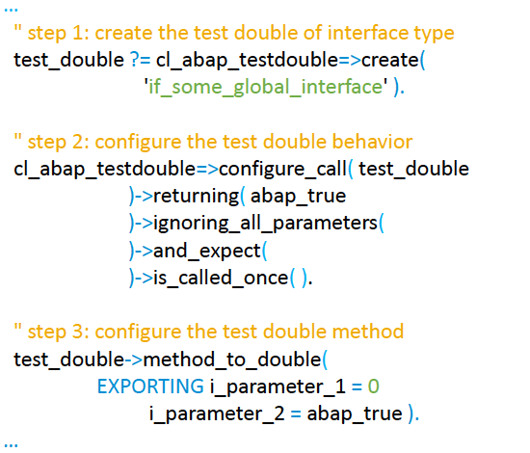
ABAP Test Double Framework
SAP NetWeaver AS ABAP 7.40 SP9 onwards
Standardized solution for creating test doubles and configuring their behavior
Supports the automatic creation of test doubles for global interfaces
Method call behavior can be configured using the framework API
It is possible to define the values of returning, exporting, and changing parameters and raise exceptions or events
Additionally, the framework provides functionality to verify interactions on the test double object, e.g. the number of times a method was called with specific input parameters
Source: OpenSAP Course Writing Testable Code for ABAP

Slide 35
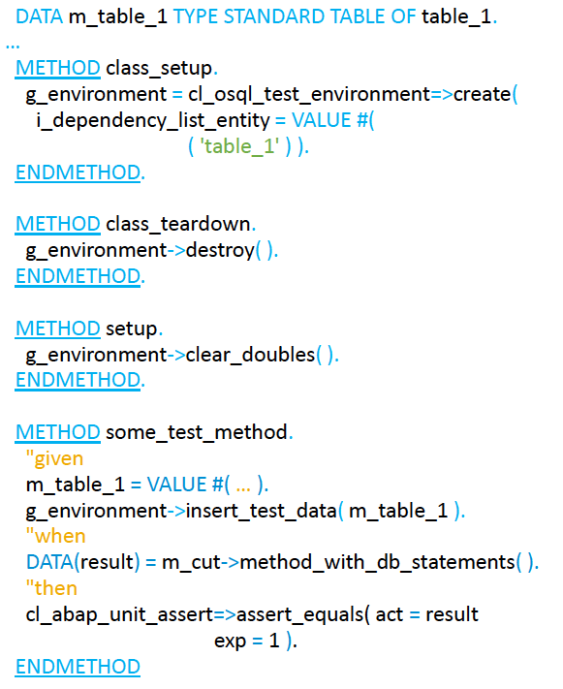
Open SQL Test Double Framework
SAP NetWeaver AS ABAP 7.52 SP00 onwards
Is an addition to the existing ABAP unit test framework
Enables testing of Open SQL statements present in your ABAP code through the normal ABAP unit test classes
It can be used for testing Open SQL logic written inside any of the development objects, e.g. classes, function modules, reports
Source: OpenSAP Course Writing Testable Code for ABAP

Slide 36
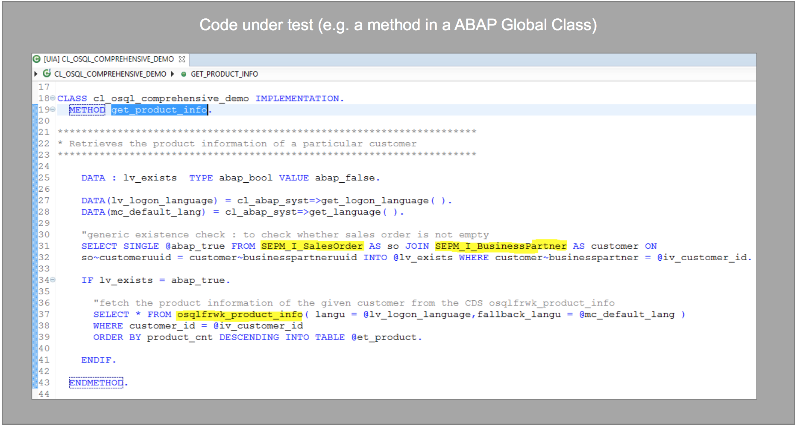
Open SQL Test Double Framework
Source: S4H232 SAP TechEd 2017

Slide 37
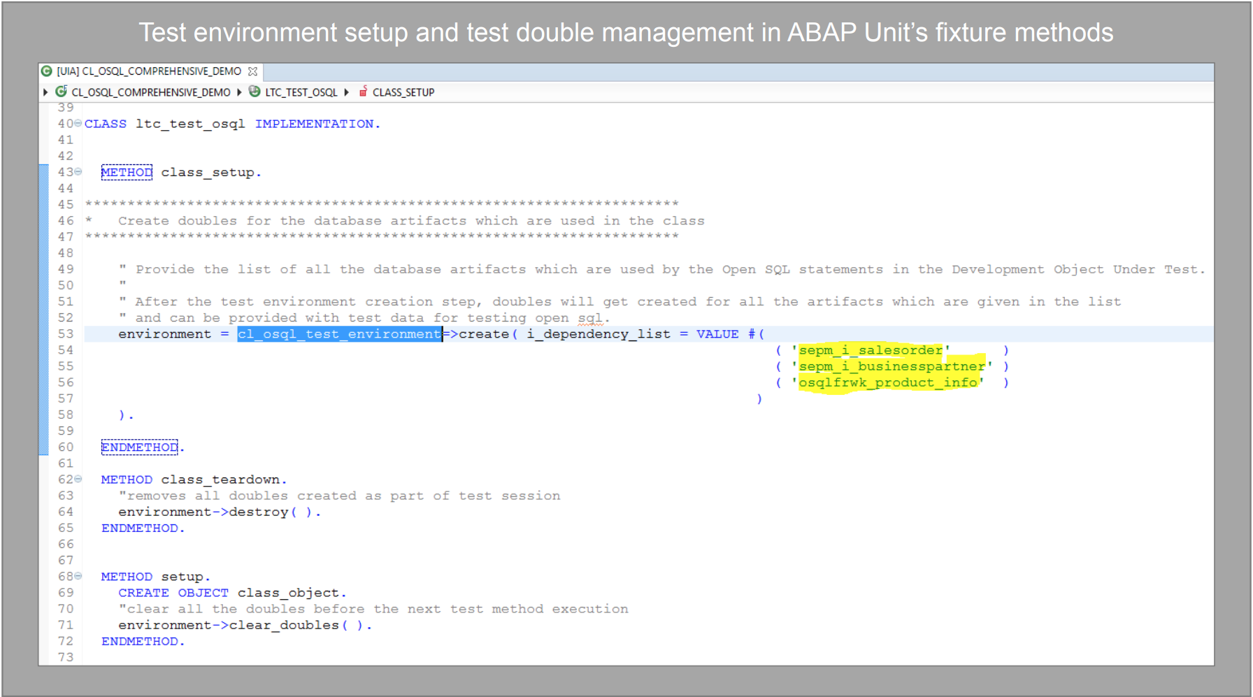
Open SQL Test Double Framework
Source: S4H232 SAP TechEd 2017

Slide 38
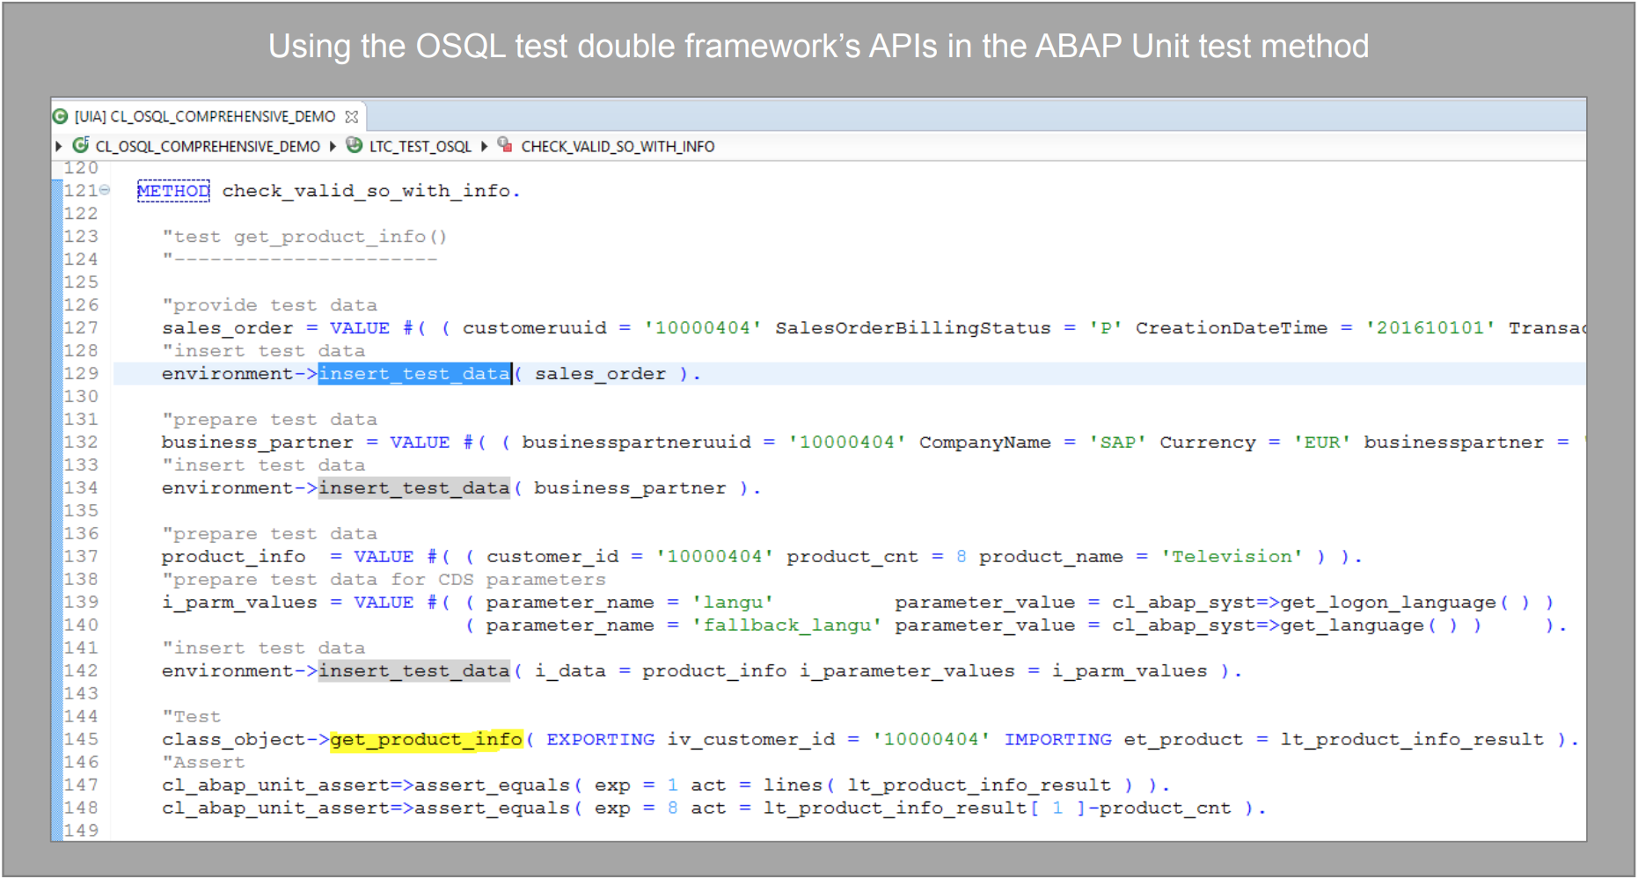
Open SQL Test Double Framework
Source: S4H232 SAP TechEd 2017

Slide 39
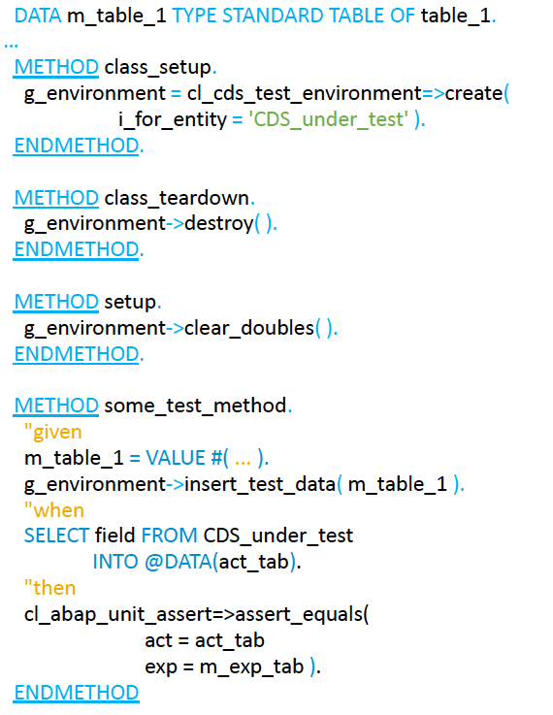
CDS Test Double Framework
SAP NetWeaver AS ABAP 7.51 SP00 onwards
Is able to double the depended-on components of CDS views
Depended-on components can be for example database tables, database views, or other CDS views
Can double all direct depended-on components, which is a unit test of the CDS view
Can double depended-on components on any hierarchy level, which then is still isolated, but tests some levels of the hierarchy
Source: OpenSAP Course Writing Testable Code for ABAP

Slide 41
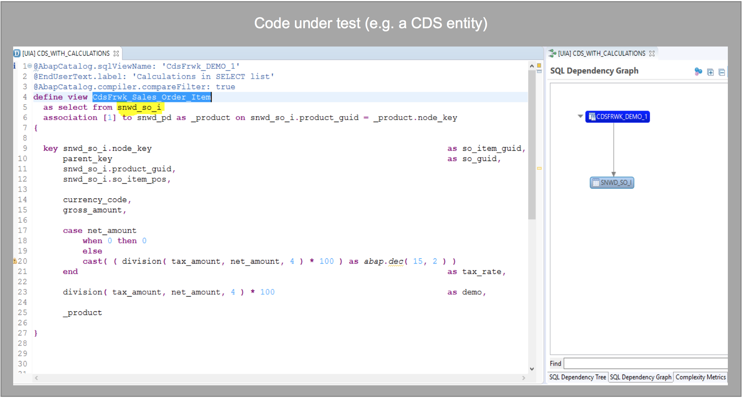
CDS Test Double Framework
Source: S4H232 SAP TechEd 2017

Slide 42
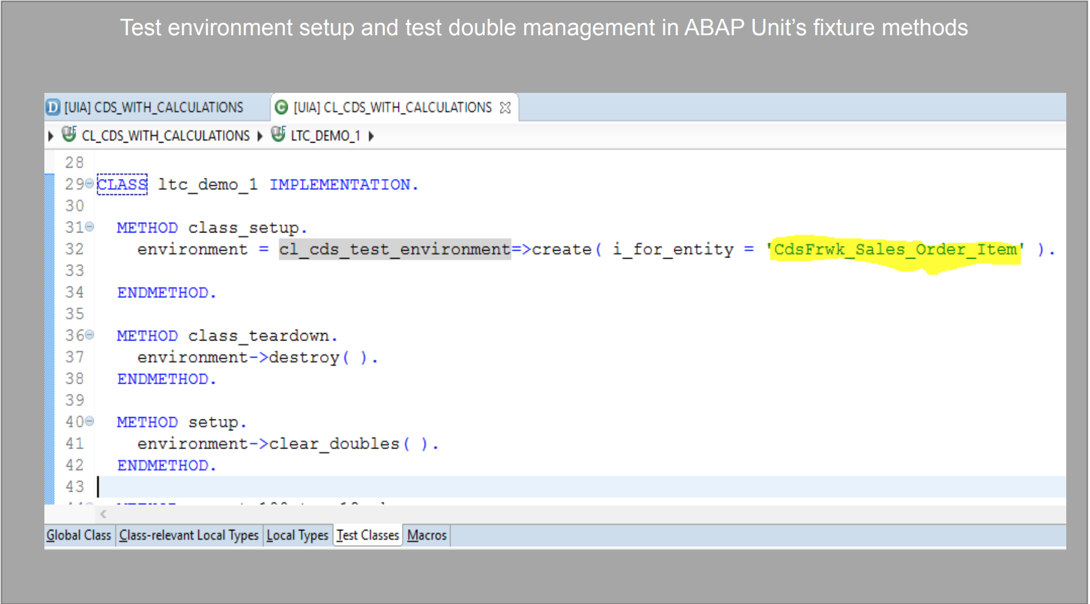
CDS Test Double Framework
Source: S4H232 SAP TechEd 2017

Slide 43
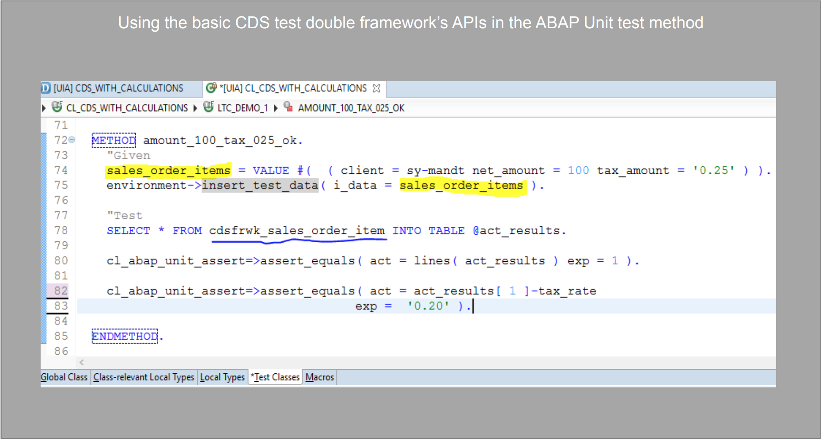
CDS Test Double Framework
Source: S4H232 SAP TechEd 2017

Slide 44
Tips from the Coal Face
Very difficult at first, easy to get disheartened, but it does get easier. Just need to willpower to stick at it until the benefits become so obvious you never want to go back.
Every time I have “fallen off the wagon” and designed and built a new piece of code first, and then added the tests afterwards, I discovered my original design was sh#t and had to radically re-do it. This happened at the start of this week for example. I did something in a hurry on a Friday just to have something to show for a progress report. A week later I came back and I couldn’t understand the sprawling spaghetti like thing I had created, that appeared to work by black magic. I started adding tests and thus was forced to unravel the knotted ball of wool until it was in a state where anyone could understand how it worked.
It is a difficult concept for someone to get their head around, but I have found it to be true that as the tests get more specific the production code is forced to become more generic.

Slide 45
Tips from the Coal Face
Very difficult at first, easy to get disheartened, but it does get easier. Just need to willpower to stick at it until the benefits become so obvious you never want to go back.
Every time I have “fallen off the wagon” and designed and built a new piece of code first, and then added the tests afterwards, I discovered my original design was sh#t and had to radically re-do it. This happened at the start of this week for example. I did something in a hurry on a Friday just to have something to show for a progress report. A week later I came back and I couldn’t understand the sprawling spaghetti like thing I had created, that appeared to work by black magic. I started adding tests and thus was forced to unravel the knotted ball of wool until it was in a state where anyone could understand how it worked.
It is a difficult concept for someone to get their head around, but I have found it to be true that as the tests get more specific the production code is forced to become more generic.
Paul Hardy

Slide 46
Tips from the Coal Face
The process is a lot faster in Eclipse because you can (a) create methods for local as well as global classes automatically via CTR+1 and the parameters are properly type and (b) you get warned about any missing interface methods in your test doubles and can automatically create all the blank ones. The latter is important.
Use the ABAP Unit Runner program to send regular emails. This very morning I got an email saying four of my unit tests had suddenly started to fail, due to something I had changed last thing yesterday afternoon. In this case it was me who had introduced a bug, but it could well have been something else, or a change in the external environment (which would indicate a dependency I had not doubled). We restrict the scope to work in progress.

Slide 47
Tips from the Coal Face
That dependency lookup thing with the factory and injector works like a charm. That is by far the best way to do dependency injection.
Test seams are an abomination
I cannot stress enough how well this is working. The instant one makes an error in the design it comes back to haunt you a few tests later and you are forced into a more elegant design….

Slide 48
Disclaimer
This presentation isn’t really about Test-driven development

Slide 49
Disclaimer
This presentation isn’t really about Test-driven development
It’s about writing testable code

Slide 50
Summary
Why
How
Some things that help
“…stick at it until the benefits become so obvious you never want to go back…”

Slide 51

https://github.com/grahamrobbo/sapteched2018

Slide 52

https://github.com/grahamrobbo/sapteched2018

Slide 53



@grahamrobbo
https://github.com/grahamrobbo/sapteched2018

Slide 55
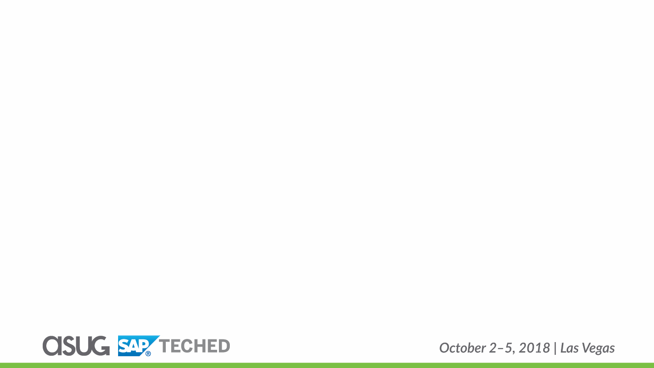
Thank you for attending my session!
For questions, contact me at:
Don’t forget to fill out the Session Evaluation on the Mobile App!
@grahamrobbo
Insert Presentation Title
Session ID# CNA415 Graham Robinson Yelcho Systems Consulting

Slide 56

Follow Us
Thank you for your time
Follow us on at @ASUG365

